Slide 1
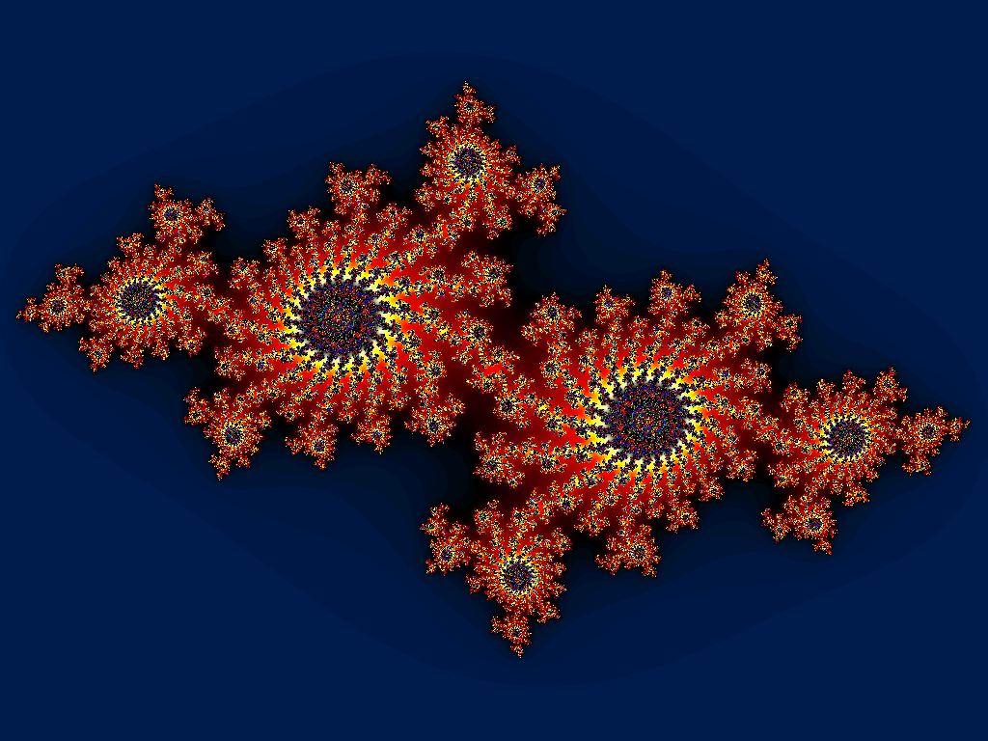
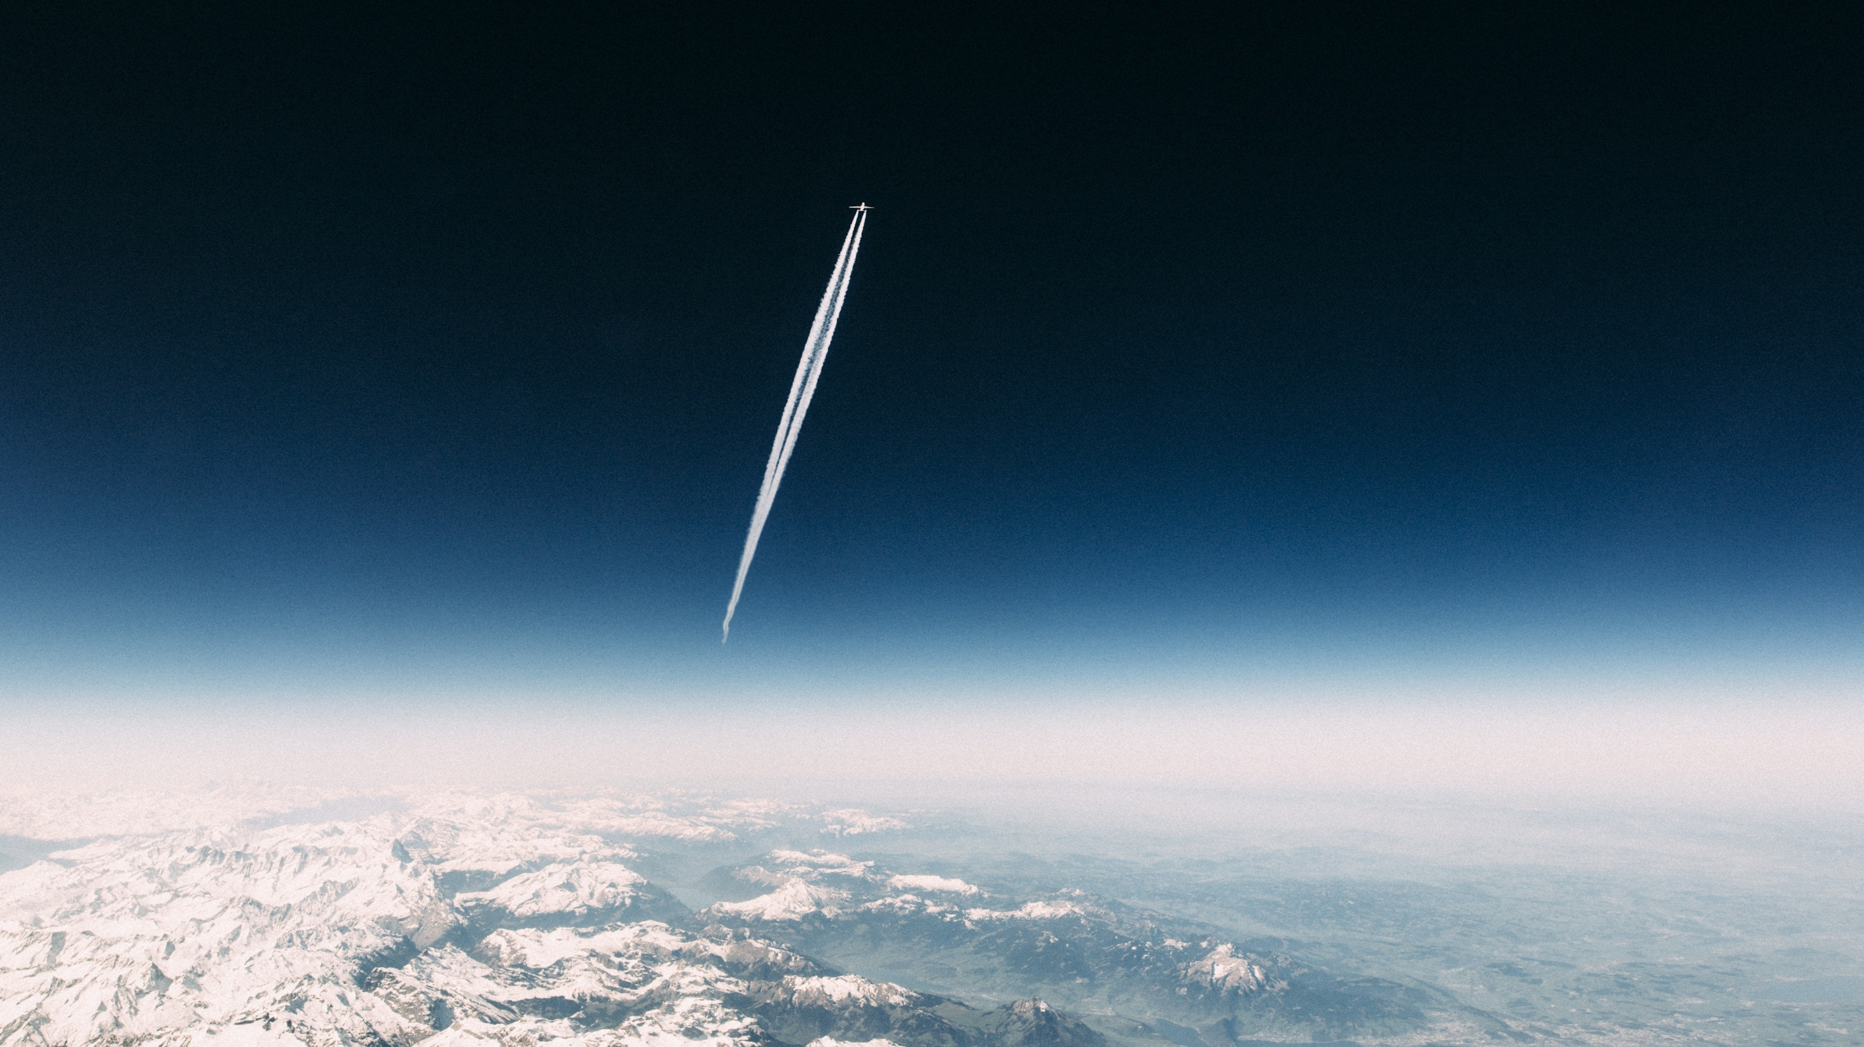
Julia Sets
Group 3 Presentation

Slide 2
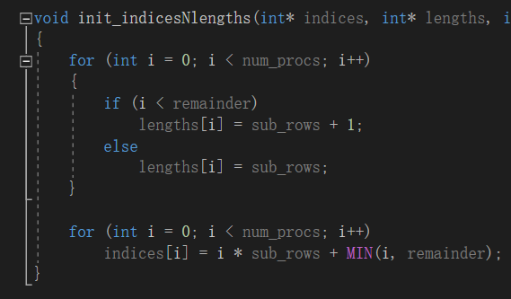
Main Idea
Load balancing
Divide the 1000 × 1000 matrix into different matrices according to the rows, and assign these split matrices to different processors.

Slide 3
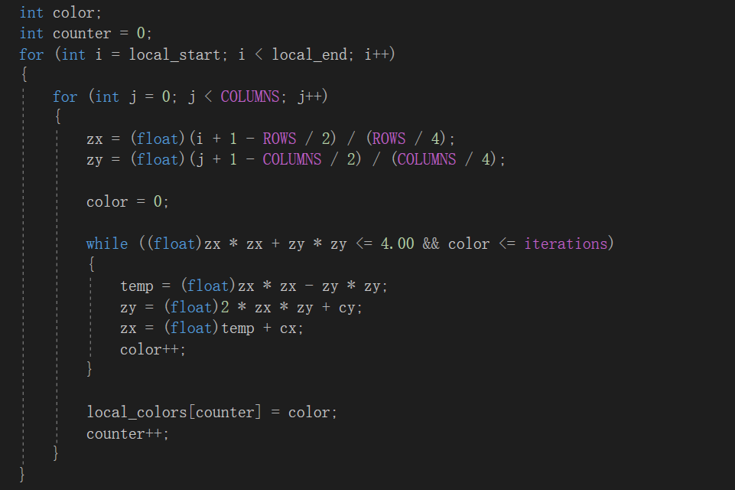
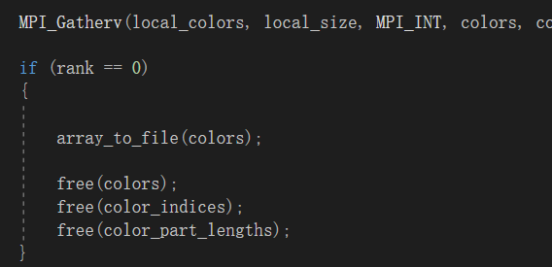
Implement Orb (z0)
Map point value to a graph
Q(z)=z^2+c
Gather data
Use MPI_Gatherv
PROCESS_0 integrates the data

Slide 4
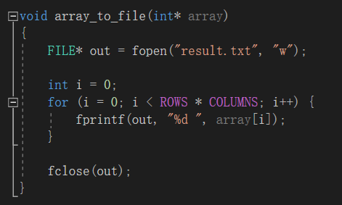
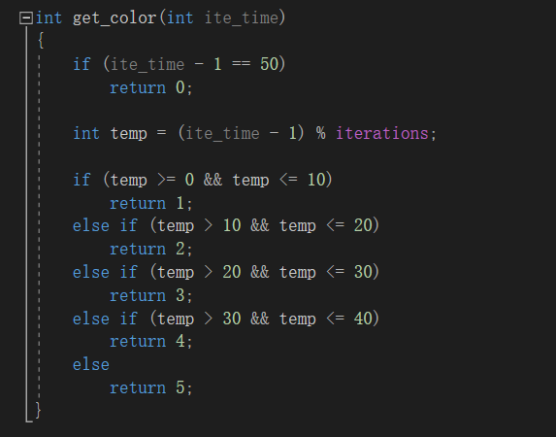
Store data
Store the data in an array and write to a file
Draw the picture
Decide color based on the #iterations.
Integrate and draw the picture based on the obtained colors.

Slide 5
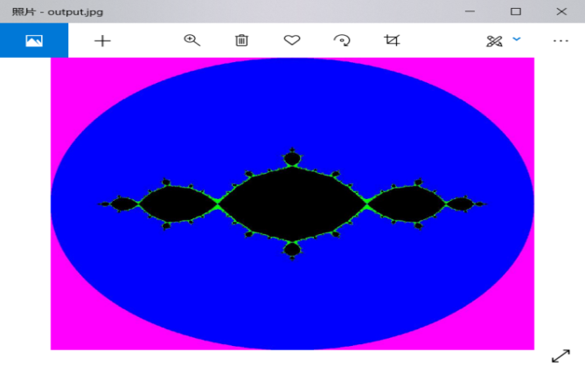
Store the picture as a jpg file
Use the “FreeImage” library
And create the “grab” function

Slide 6

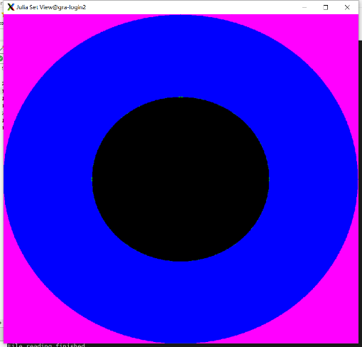
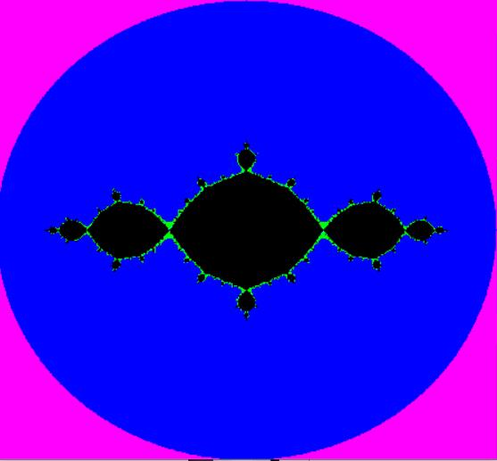
Result
C=0
C=-1

Slide 7



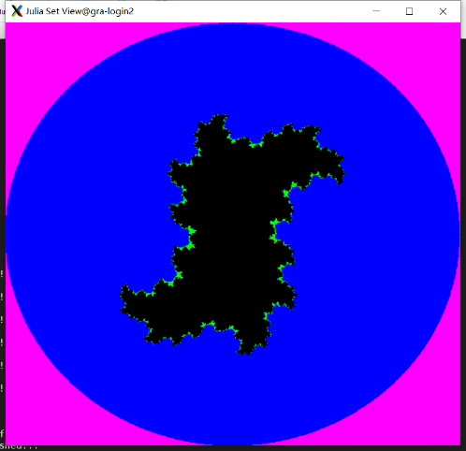
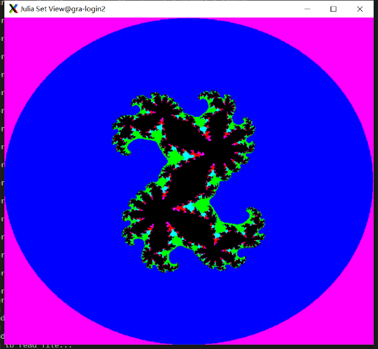
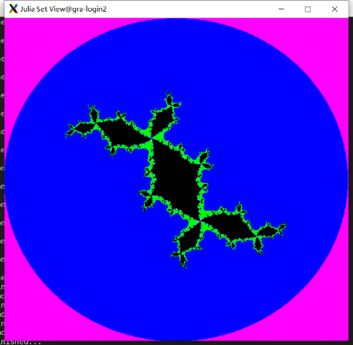

C=0.3-0.4i
C=0.360284+0.10036i
C=-0.1+0.8i

Slide 8
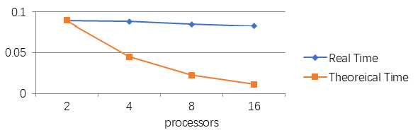
Benchmark

Slide 9
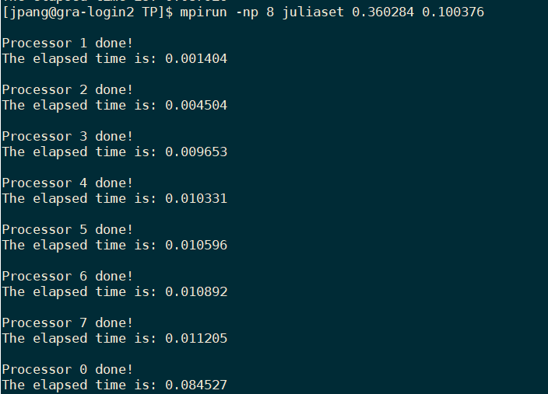
Comments on the result

Parallel overhead
☞
...

...

Slide 10
THANK YOU
Group 3 Presentation

